Slide 1
Color Memory
a card based puzzle game

Slide 2
Goals & Targets
Given the strict timeline, we had to come up with a set of goals which we wish to achieve through this project.
Create a simple memory card game
We're focusing on giving the game a good UI/UX for great user experience.
This includes having good design features and crisp & intuitive animations
We're also planning on having different card designs for users to collect.

Slide 3
Feature List: Design
Colour Palette:
The colour palette is inspired from Base16: Ocean. We plan to make both light and dark versions of the interface using the same palette.
Smooth card flip animations.
Fluid gameplay and intuitive gestures.

Slide 4
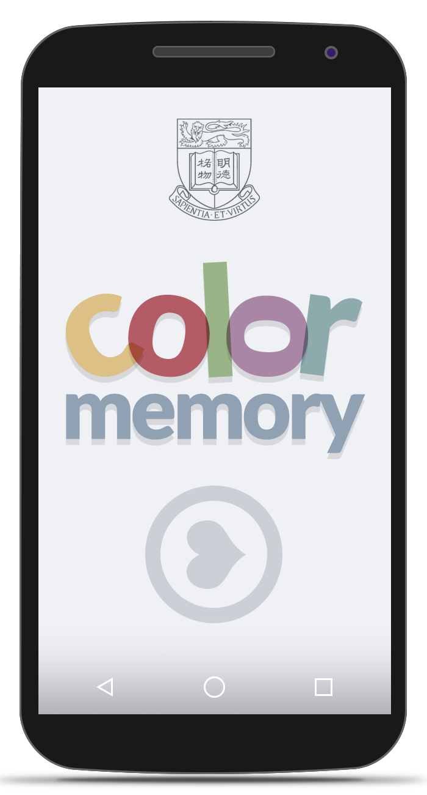
Concept Mockup
This is the first pass on the app’s design and aesthetics. Some pointers about the design process:
In accordance to the brief, we have decided to incorporate the HKU logo on the starting page itself. The logo has been redrawn for this purpose with a wireframe look to fit the minimalism we strive for.
The app logo has been designed to make it both inviting with the use of colours, as well as interesting by introducing asymmetry.

Slide 5
Feature List: Gameplay
Some features
Memory Card Game with time limit
  Player has limited amount of time to pair as many cards as possible. If player has already paired all the cards while he still has some time, a new set of cards will appear so that the player can try to earn more points
  Doing combos gives adds more time. Example of combo: opening cards
Different Card artwork
  Players can unlock different card artwork using in-game currency earned while playing the game
  If time permits, we might include animating cards.

Slide 6
Technical Specifications
Specs:
Platform: Android
Tools: Java, Android, Eclipse, GIMP (for designing)
Deploy Targets: Android Phones and Tablets.

Slide 7
Potential Pitfalls
List some issues that may occur – Not sure what to write here: Janssen
Our main concern is how to make a simple classic game into something that would make players want to play it over and over again.
With design
Or with code
Or something else..

Slide 8
Timeline
Intended work schedule goes here
June 28 – Jul 11:
  Create the game basics - memory card game with the arcade mechanics
  Create basic assets – card design, UI objects, etc
July 12 – July 18:
  Highscore system
  Add the in-game currency
  Add the unlockable – new card designs. Maybe make animating cards
July20 – July 25
  Game Testing

Slide 9
Responsibilities
Rahul
Minimalist Designer
Rebellious Programmer
Documentation Ninja
Janssen
Resident Design Expert
Programming Guru
Documentation Apprentice
We have an unusually creative process of dividing responsibilities, and we are not sure whether it’s quantifiable.

Slide 10
Thank you
members:
Janssen Marwin Go 3035150696
Rahul Kumar Thakur 2013854618

